Slide 1
GreenLedger
Carbon footprint,
made provable.
NET EMISSIONS ● on-chain
25,024 kg CO₂e
Scope 1 18,454 kg
Scope 2 15,500 kg
CBAM-ready, blockchain-verified carbon tracking for SMEs.
Scope 3 8,070 kg
0x0d9b…cd79c ✓ verified · Scimatic
Said Nadeem · CTO Furkan Temel · Fullstack Syed A. U. Shah · Carbon Science
TÜBİTAK BİGG · UNIDO GCIP · PATENT-FILED TR+PCT

Slide 2
01 — OVERVIEW
An affordable way to prove your carbon footprint.
What
Who for
SaaS that records & verifies SME emissions on an energy-efficient blockchain.
SMEs exporting to the EU that must comply with CBAM.
Model
Stage
$6,000 one-time setup + on-chain transaction fees.
TRL 5 · 50+ validation meetings · revenue live · patents filed.

Slide 3
02 — PROBLEM
CBAM hits in 2026.
SMEs aren't ready.
SMEs exporting to the EU face heavy penalties and lost contracts without verified emissions data.
€50–200K
73%
€1,500+/mo
Trust gap
Penalty exposure
of exporting SMEs at risk
Enterprise tools too costly
Spreadsheets can't prove to auditors
📄 Today: manual spreadsheets
⛓ GreenLedger
→
✕ Rejected by auditor
✓ On-chain verified

Slide 4
03 — SOLUTION
Record once. Verify forever.
Turn unverifiable paperwork into immutable, audit-ready proof.
01
02
03
Track
Verify
Report
Log emissions in one dashboard.
Timestamped, tamper-proof on-chain record.
One-click EU-formatted verified report.

Slide 5
04 — MARKET
A global market.
~12M
TAM
Global SMEs exporting in CBAM-scope sectors
~400K
SAM
SMEs reporting embedded emissions into EU+UK
5,000
SOM
2028 target · Türkiye→EU→UK corridor
EU CBAM 2026 · UK CBAM 2027

Slide 6
05 — GO-TO-MARKET
We follow the export corridor.
🇹🇷
🇩🇪
🇪🇺
🌍
Türkiye
→
Germany
→
EU + UK
→
Global
Phase 1 · Home market via associations
Phase 2 · EU's top CBAM importer
Phase 3 · Across member states
Phase 4 · Scale

Slide 7
06 — COMPETITION
Cheaper, simpler, and provable.
Consultants
Enterprise SaaS
GreenLedger
Price
~€7,600/engagement
€1,500+/mo
$6,000 once + usage
For SMEs
Too costly
Too complex
Built for SMEs
On-chain proof
No
No
Yes — immutable
CBAM-ready
Manual
Partial
One-click

Slide 8
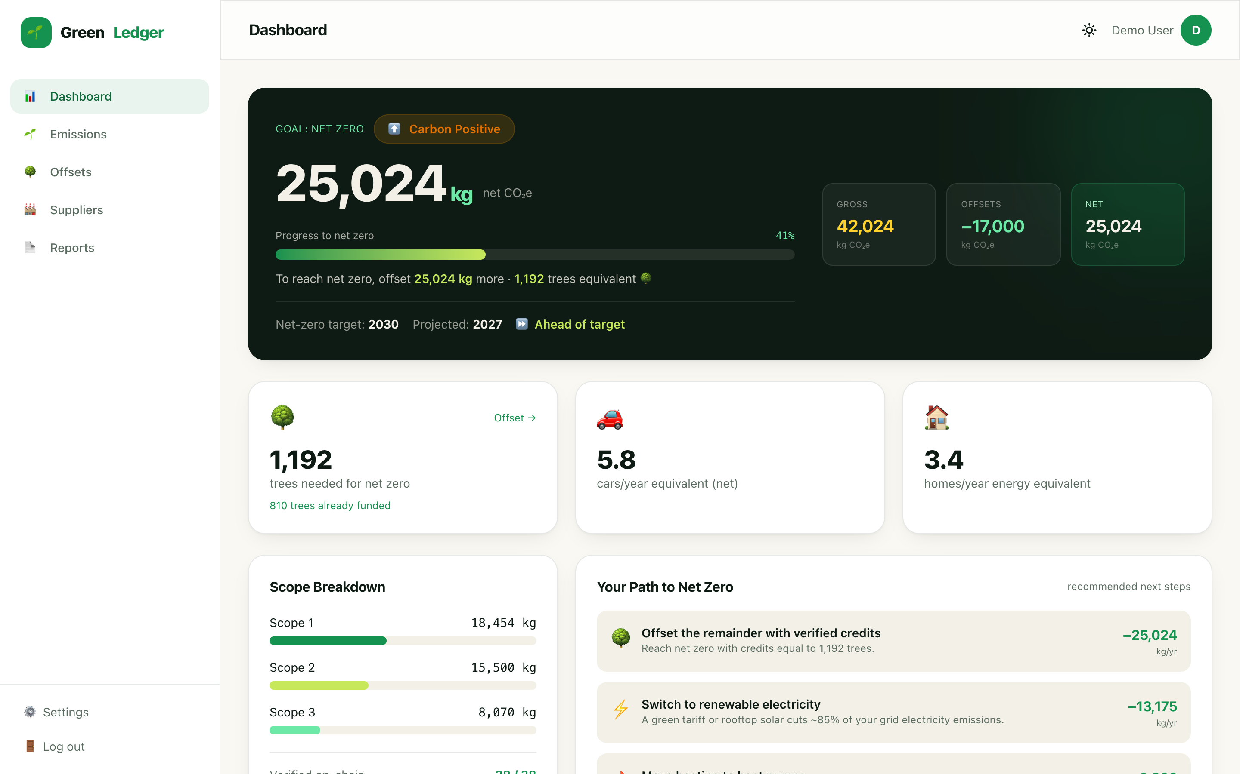
07 — PRODUCT
One dashboard,
a real product.
● Emissions dashboard
No carbon expertise required
● On-chain verification
Tamper-proof records on Scimatic
● CBAM reports
One-click EU-formatted PDF
LIVE: greenledger.zincirx.com

Slide 9
08 — PLATFORM
End-to-end, not a feature.
Measure, reduce, offset, collect from suppliers, verify and report — one product, all proven on-chain.
Measure
Reduce
Offset
Collect
Verify
Report
3 scopes
Smart tips
With proof
From suppliers
On-chain
CBAM + ISO

Slide 10
09 — TECHNOLOGY
Proof-of-stake. Patent-protected.
ERP / Data
→
Smart Contract
→
Scimatic / BSC
→
Immutable Proof
Energy-efficient chains
Maturity
Scimatic + BSC + Polygon (PoS)
TRL 5 — validated in relevant environment
Smart contracts
IP
Automated, auditable verification
TR + PCT patents · Zincirx trademark

Slide 11
10 — IMPACT
Saving the planet,
not just paperwork.
2.4M
99.9%
500+
tons CO₂e tracked by 2027
less energy
pages/SME/yr
ENERGY PER TRANSACTION

Slide 12
11 — BUSINESS MODEL
Predictable SaaS revenue.
────────
────────
────────
$6,000
+ Usage
↑ Grow
One-time setup
Transaction fees
Land & grow
Per new customer
Blockchain-based, recurring
New chains, markets, modules

Slide 13
12 — TEAM
Two PhDs, one builder.
SN
ST
FT
Said Nadeem
Syed A. U. Shah
Furkan Temel
CTO · Blockchain
Carbon Science
Fullstack
PhD, Computer Science
PhD, Environmental Eng.
Software Engineering
20+ years of combined experience across blockchain, full-stack development and carbon science.

Slide 14
13 — FINANCIALS
Raising
$300K.
REVENUE PROJECTION (€)
Early traction — $18,000 booked from three customers:
EFBA $6,000
Polimed R&D $6,000
Nurer İncir Ltd. $6,000
Non-dilutive: TÜBİTAK BİGG · KOSGEB · Türk Patent · Teknopark · PCT

Slide 15
14 — MODEL
Profitable by Year 3.
€202K
€1.89M
€4.86M
2025 revenue
2026 revenue
2027 revenue
Pilot phase
Scaling
EBITDA positive
Recurring on-chain transaction fees compound as customers grow.

Slide 16
Let's make compliance
the easy part.
GreenLedger · YeşilDefter
Said Nadeem · CTO
contact@greenledger.io greenledger.zincirx.com

